Slide 1
PROBLEM STATEMENT TITLE: SOFTWARE SOLUTIONS TO IDENTIFY USERS BEHIND TELEGRAM,WHATSAPP AND INSTAGRAM BASED DRUG TRAFFICKING
TEAM NAME: IDEA IGNITERS
TEAM MEMBERS:
1.LESA:B.Tech AIDS
2.HEMADEVI: B.E. IT
3.MOHANA PRIYA A V: B.E. EIE
4.MATHUMITHA M: B.E.CSE
2nd Year - Kumaraguru

Slide 2
Problem Statement: "Developing Software Solutions to Identify Users Behind Telegram, WhatsApp, and Instagram-Based Drug Trafficking”
Context:
The rise of social media and messaging apps has enabled drug traffickers to exploit these platforms for illicit activities.
Telegram, WhatsApp, and Instagram have become breeding grounds for drug trafficking, with criminals leveraging end-to-end encryption, anonymous accounts, and coded language to evade detection.
Challenge:
Law enforcement agencies and organizations face significant challenges in identifying and tracking down drug traffickers on these platforms.
The anonymous nature of these platforms, combined with the vast volume of data, makes it difficult to pinpoint suspicious activity and identify the individuals behind it.

Slide 3
APPROACH 1
APPROACH 1:
APPLYING OCR ON SAMPLE CHAT DATA:
Extracting text from the chat
Compares the text in the screenshot with suspected words list and classifies accordingly with the date , location and timing
DRAWBACK:
Cannot extract the conversation because it is end-to-end encrypted

Slide 4
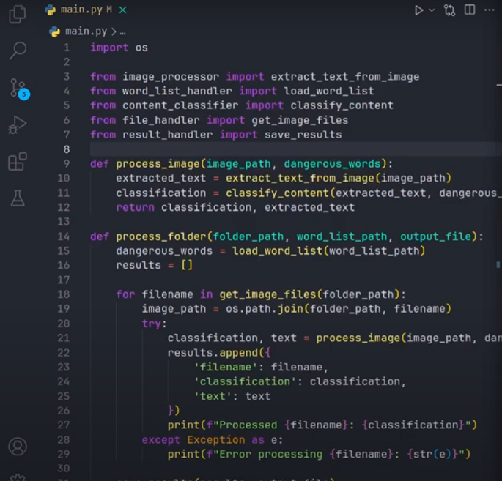
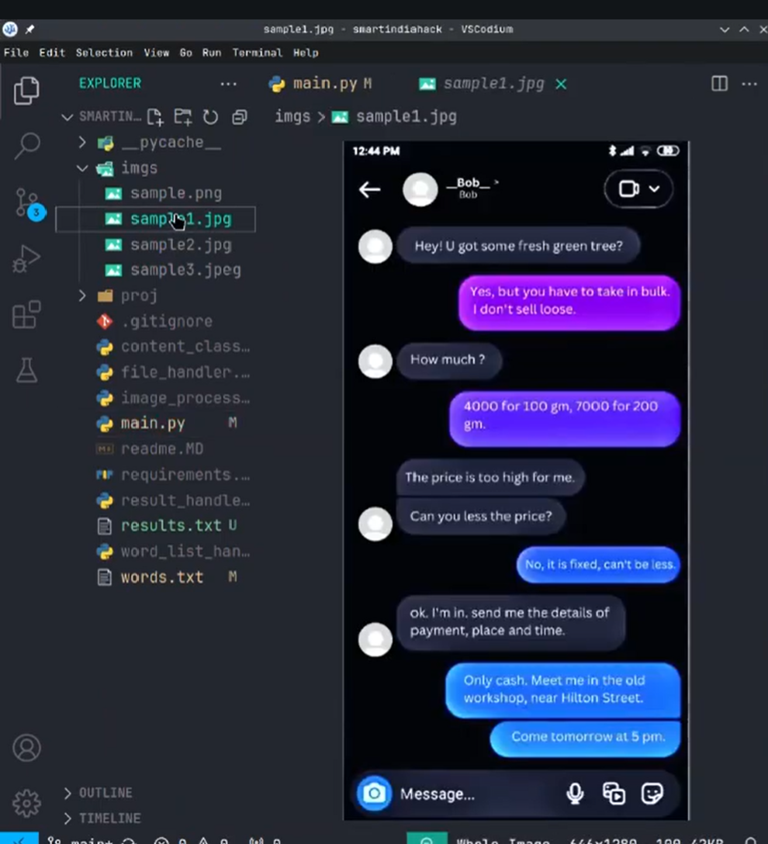

Slide 5
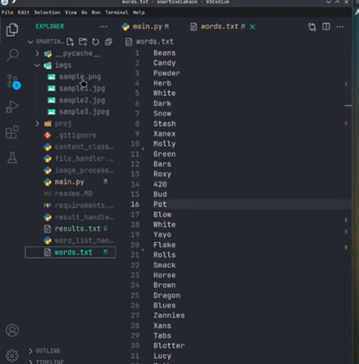
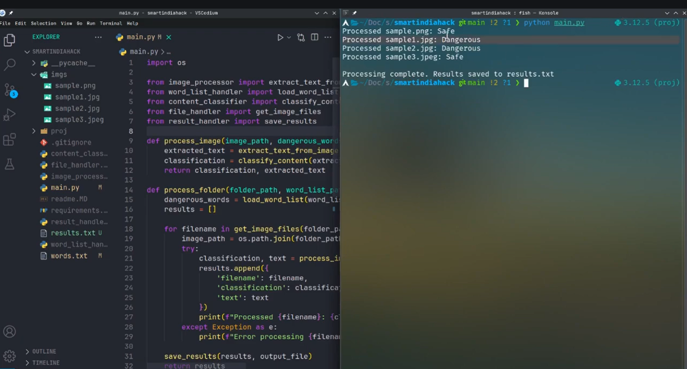

Slide 6
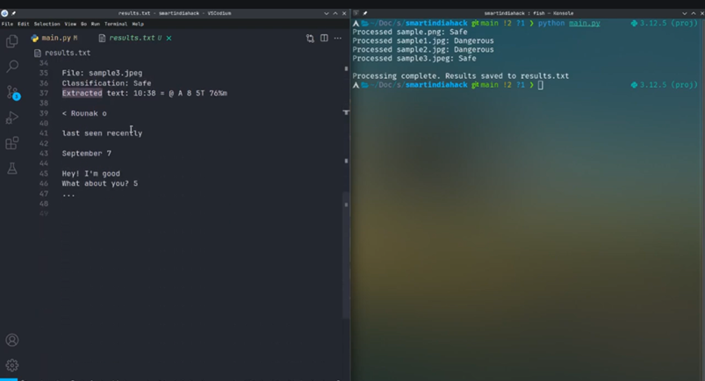

Slide 7

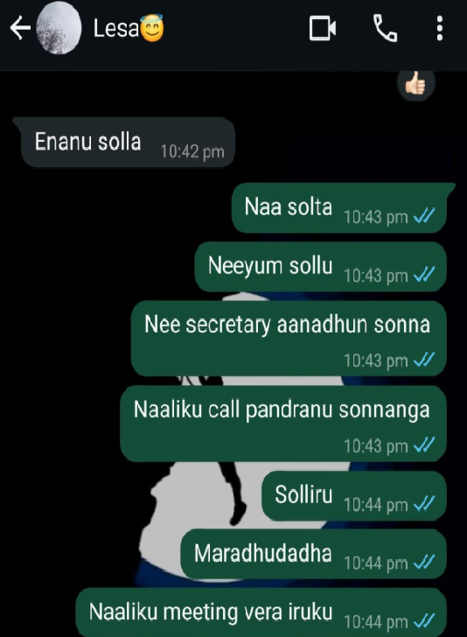
APPROACH 2
META DATA ANALYSIS:
1.Pattern analysis
2.Network analysis
3.Geospatial analysis
4.Temporal analysis
PATTERN ANALYSIS:
Identify patterns in communication,such as frequent messages or calls between individuals
DRAWBACK:
Though the given example is not related to drug related conversation, the conversation takes place at the unusual time and more frequently. So it can indicate a suspicious activity leading to false positives and incorrect decisons

Slide 8

APPROACH 3
DATA COLLECTION: Collect multimodel data to create largescale datasets. Data is collected through webscraping or hashtag search API
MODEL ARCHITECTURE: Designed an unsupervised learning method algorithm
PREPROCESSING: Novel quadraple-based data representation (image vs text vs post vs homepage)
TRAINING: Train the model using labelled data in the training set having both positive and negative instanances
TESTING: evaluate system performance using its prediction (accuracy, response time)
OPTIMISATION: Tune model for better efficiency and accuracy

Slide 9
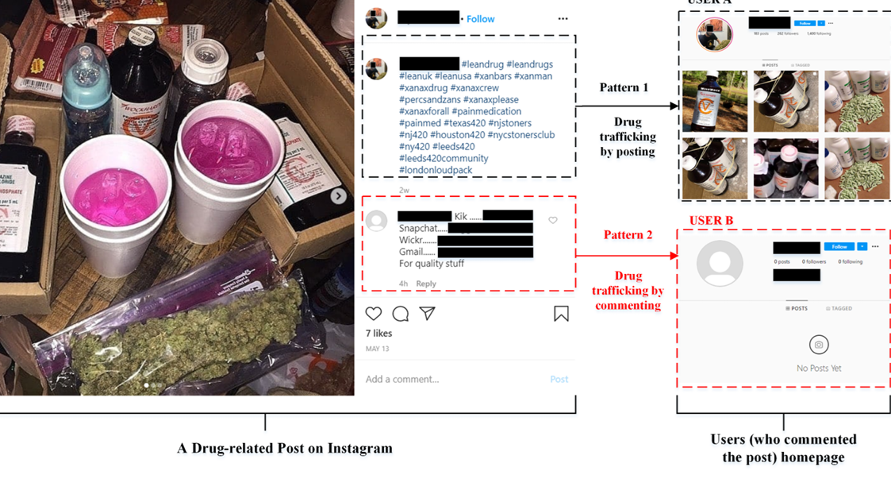

Slide 10
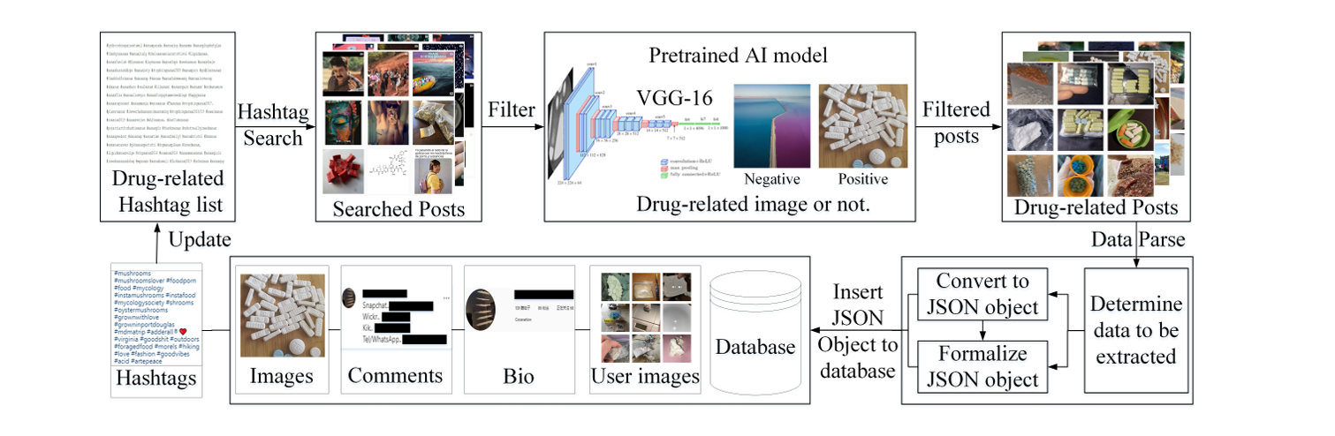

Slide 11
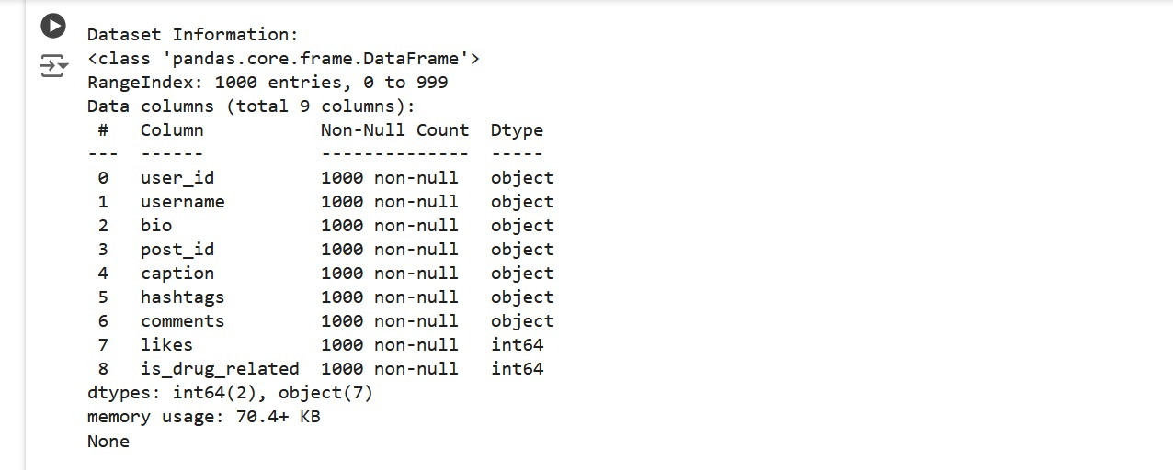

Slide 12
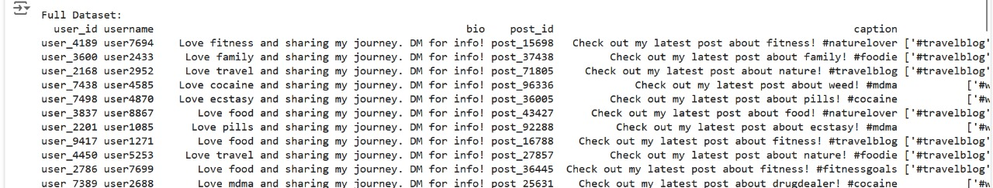

Slide 13
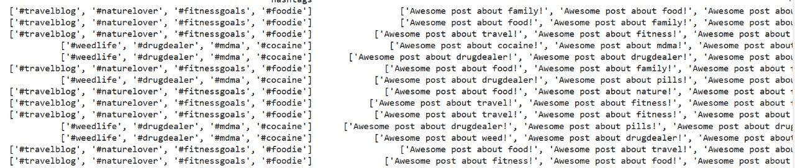

Slide 14
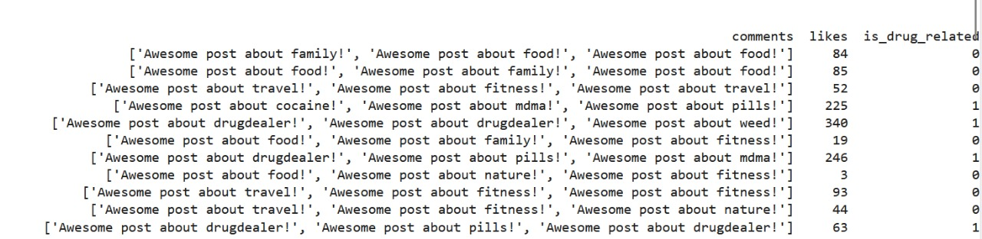

Slide 15
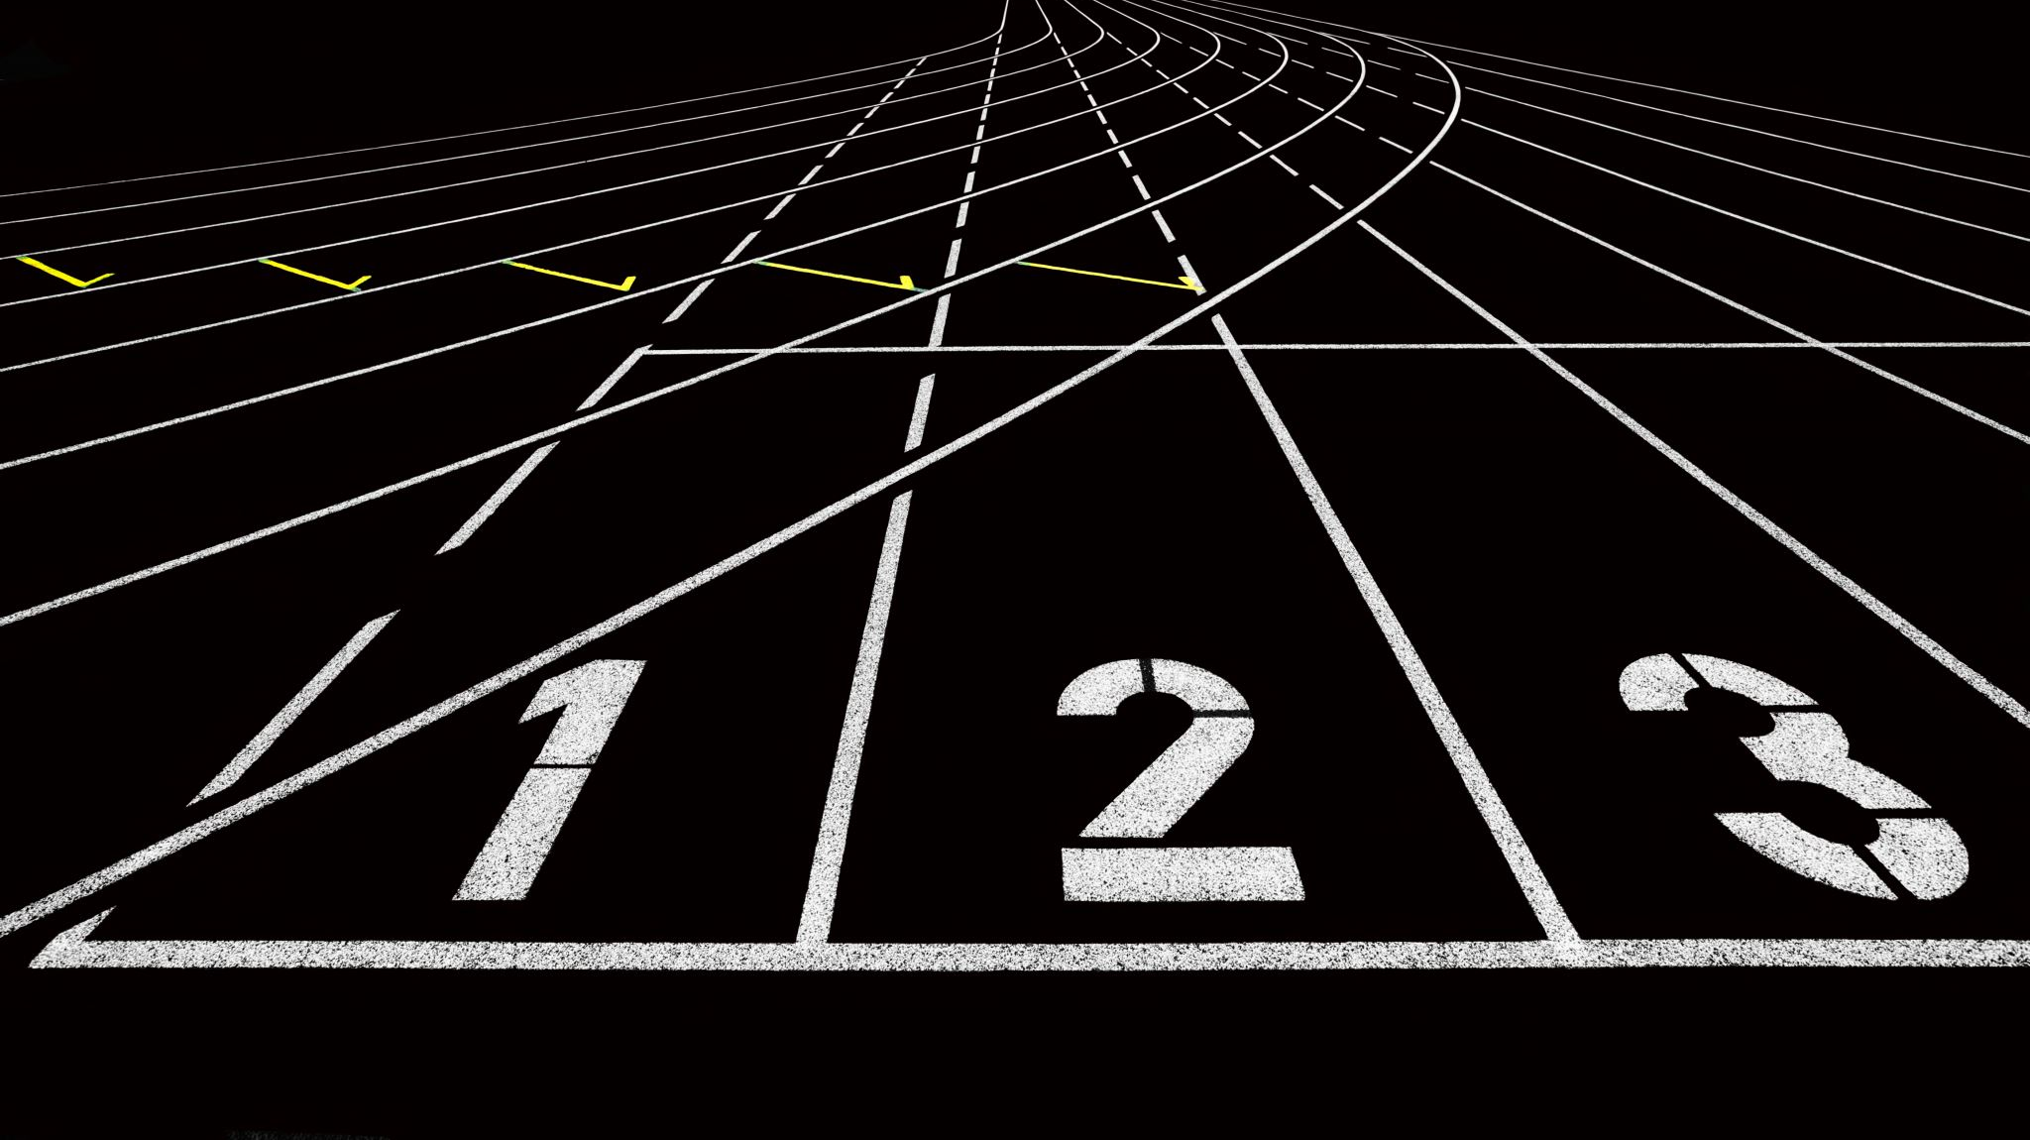
APPROACH 4

Slide 16

Initial Approach:
Build a custom Large Language Model (LLM) from scratch to identify users behind drug trafficking on WhatsApp, Instagram, etc.
Revised Approach :
Leverage pre-trained LLM models (e.g., Gemini, chatGPT) for efficiency and accuracy.
Utilize pre-trained models to:
Reduce development time and resources
Tap into vast amounts of pre-trained data
Focus on prompt engineering for optimal results
How it Works?
1. Provide prompt and data to the pre-trained LLM model
2. Receive answers and insights based on the input
Aim is to Develop an end – to- end encrypted app which is LLM model application with the help of gemini API key for accurate results and efficient analysis.
Benefits:
Improved efficiency, accuracy, and security in identifying users behind drug trafficking on social media platforms.

Slide 17
Current Technology Stack
1. RAG in ILM-Based Web App
Integrates retrieval-augmented generation to provide context-enriched responses.
Uses external knowledge for dynamic, high-quality outputs.
2. Vector Database for Semantic
SearchStores data embeddings for fast, accurate semantic search.
Enhances personalization and relevance of results.
Technologies: Pinecone, Weaviate, or Milvus.

Slide 18
Future Vision
1.Knowledge Graph Integration
Uncovers relationships between data points.
Enables complex queries like discovering connections in styles or themes.
Provides a comprehensive and intuitive data network.
2.Key Benefits
Enhanced collaboration and discovery.
Scalable and future-ready architecture.

Slide 19

THANK YOU

